Slide 1

Data Visualization
Felipe Rodriguez

Slide 2
Overview
What is data visualization?
Why does it help?
Things to consider
Examples

Slide 3

What is data visualization?
Data Visualization is '"the formation of mental visual images to convey information through graphical representations of data" (2019, Stewart)
Important in conveying information in an organized way
Different tools can aid with visualization
Examples: Power BI, Tableau, Excel
Offers different varieties based on what needs to be analyzed
Examples: Line graph, charts, tables

Slide 4

Why does it help?
Provide an easier was to read data
Can be quicker than analyzing raw data
Can give insight to correlations

Slide 5

Things to consider
Color gradients
Sizing and limits
Correct usage – pie charts for comparisons, line graphs for trends

Slide 6
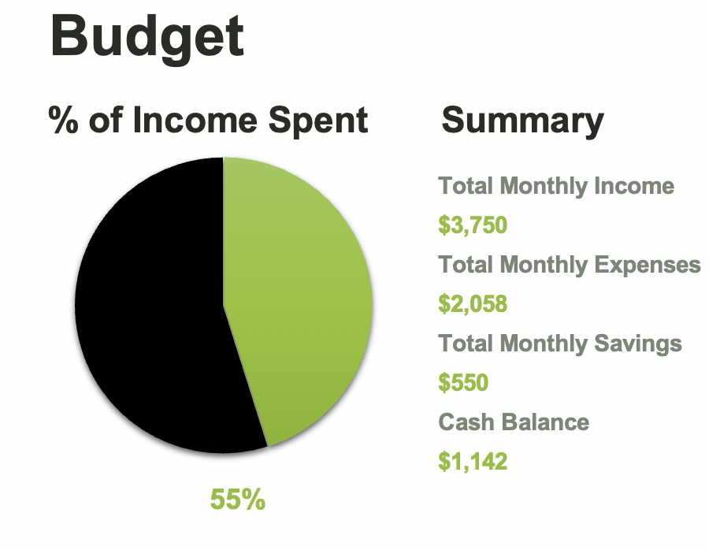
Example
Benefits
Snapshot from excel
Quickly show summary
Percentage of income spent easy to show

Slide 7
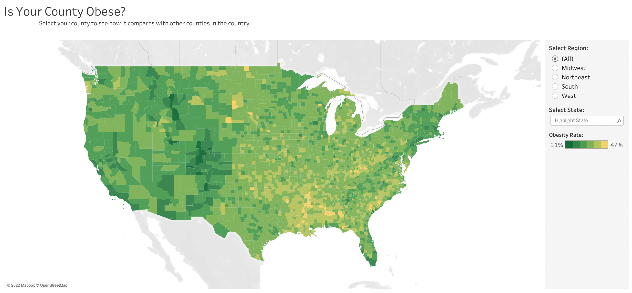
Example
Snapshot from tableau
Color gradients make it easy to identify
Easily identify counties

Slide 8
Summary
Data visuals are important in showcasing data
It is important to select the correct type depending on data
Different types of tools to use
Consider the audience when selecting a visual

Slide 9
references
Stewart, M. (2019, May 15). Towards data science. The Power of Visualization in Data Science. Retrieved November 19, 2022, from https://towardsdatascience.com/

